Slide 1


Computer Architecture Spring 2020
Hamed Farbeh
farbeh@aut.ac.ir
Department of Computer Engineering
Amirkabir University of Technology
BASIC COMPUTER ORGANIZATION AND DESIGN

Slide 2
Outlines
• Instruction Codes
• Computer Registers
• Computer Instructions
• Timing and Control
• Instruction Cycle
• Memory Reference Instructions
• Input-Output and Interrupt
• Complete Computer Description
• Design of Basic Computer
• Design of Accumulator Logic
Computer Architecture-Spring 2020, AUT, Tehran, Iran

Slide 3
CONTROL UNIT
Control unit (CU) of a processor translates from machine instructions to the control signals for the microoperations that implement them
Control units are implemented in one of two ways
Hardwired Control
CU is made up of sequential and combinational circuits to generate the control signals
Microprogrammed Control
A control memory on the processor contains microprograms that activate the necessary control signals
We will consider a hardwired implementation of the control unit for the Basic Computer
Computer Architecture-Spring 2020, AUT, Tehran, Iran

Slide 4
TIMING AND CONTROL
Control unit of Basic Computer
Instruction register (IR)
15
14 13 12
11 - 0
Other inputs
3 x 8
decoder
7 6 5 4 3 2 1 0
D
0
Combinational
Control
logic
I
D
Control
signals
7
T
15
T
0
15 14 . . . . 2 1 0
4 x 16
decoder
4-bit
Increment (INR)
sequence
Clear (CLR)
counter
Clock
(SC)
Computer Architecture-Spring 2020, AUT, Tehran, Iran

Slide 5
TIMING SIGNALS
- Generated by 4-bit sequence counter and 4×16 decoder
- The SC can be incremented or cleared.
- Example: T₀, T₁, T₂, T₃, T₄, T₀, T₁, . . .
Assume: At time T₄, SC is cleared to 0 if decoder output D3 is active.
D₃T₄: SC ←0
Computer Architecture-Spring 2020, AUT, Tehran, Iran

Slide 6
INSTRUCTION CYCLE
In Basic Computer, a machine instruction is executed in the following cycle:
Fetch an instruction from memory
Decode the instruction
Read the effective address from memory if the instruction has an indirect address
Execute the instruction
After an instruction is executed, the cycle starts again at step 1, for the next instruction
Note: Every different processor has its own (different) instruction cycle
Computer Architecture-Spring 2020, AUT, Tehran, Iran

Slide 7
FETCH and DECODE
• Fetch and Decode
T0: AR ← PC (S₀S₁S₂=010, T₀=1)
T1: IR ← M [AR], PC ← PC + 1 (S₀S₁S₂=111, T₁=1)
T2: D0, . . . , D7 ← Decode IR(12-14), AR ← IR(0-11), I ← IR(15)
T1
S₂
T0
S₁
Bus
S₀
Memory
7
unit
Address
Read
AR
1
LD
PC
2
INR
IR
5
LD
Clock
Common bus
Computer Architecture-Spring 2020, AUT, Tehran, Iran

Slide 8
DETERMINE THE TYPE OF INSTRUCTION
Start
SC ← 0
AR
←
PC
T0
T1
IR
←
M[AR],
PC
←
PC + 1
T2
Decode Opcode in IR(12-14),
AR
←
IR(0-11),
←
I
IR(15)
(Register or I/O) = 1
D7
= 0 (Memory-reference)
(I/O) = 1
= 0 (register)
(indirect) = 1
= 0 (direct)
I
I
T3
T3
T3
T3
Execute
Execute
AR
←
M[AR]
Nothing
input-output
register-reference
instruction
instruction
SC
←
0
SC
←
0
Execute
T4
memory-reference
instruction
SC
←
0
D'7IT3: AR ← M[AR]
D'7I'T3: Nothing
D7I'T3: Execute a register-reference instr.
D7IT3: Execute an input-output instr.
Computer Architecture-Spring 2020, AUT, Tehran, Iran

Slide 9
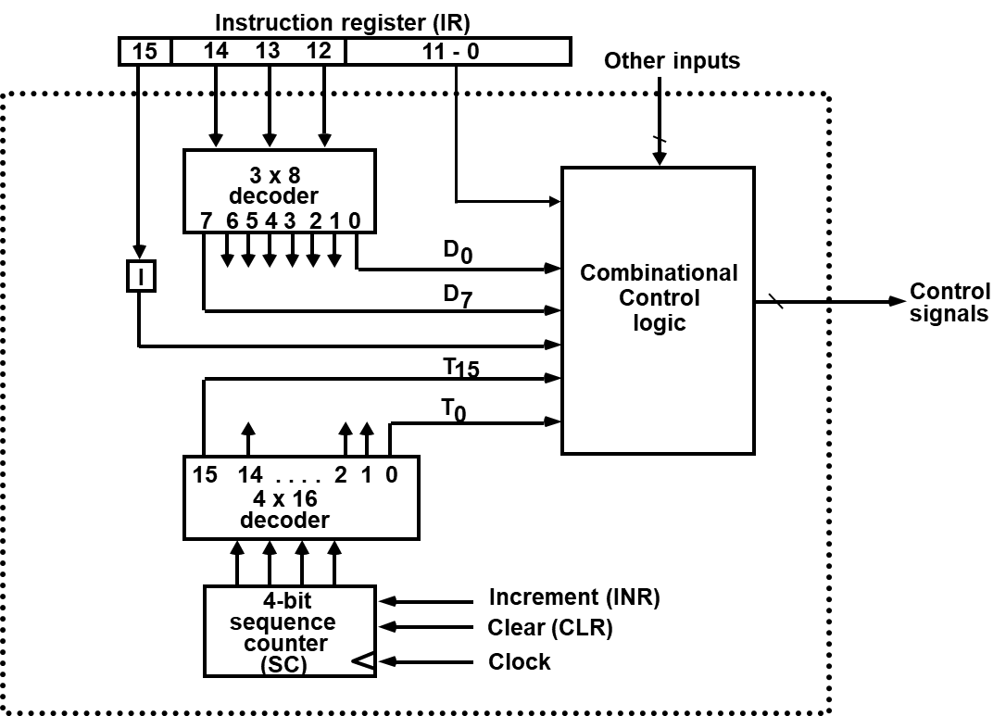
REGISTER REFERENCE INSTRUCTIONS
Register Reference Instructions are identified when
- D₇ = 1, I = 0
- Register Ref. Instr. is specified in b₀ ~ b₁₁ of IR
- Execution starts with timing signal T₃
r = D₇ I′T₃ => Register Reference Instruction
B_{i} = IR(i) , i=0,1,2,...,11
r: SC ← 0
CLA rB₁₁: AC ← 0
CLE rB₁₀: E ← 0
CMA rB₉: AC ← AC’
CME rB₈: E ← E’
CIR rB₇: AC ← shr AC, AC(15) ← E, E ← AC(0)
CIL rB₆: AC ← shl AC, AC(0) ← E, E ← AC(15)
INC rB₅: AC ← AC + 1
SPA rB₄: if (AC(15) = 0) then (PC ← PC+1)
SNA rB₃: if (AC(15) = 1) then (PC ← PC+1)
SZA rB₂: if (AC = 0) then (PC ← PC+1)
SZE rB₁: if (E = 0) then (PC ← PC+1)
HLT rB₀: S ← 0 (S is a start-stop flip-flop)
Computer Architecture-Spring 2020, AUT, Tehran, Iran

Slide 10
MEMORY REFERENCE INSTRUCTIONS
Symbol
Operation
Decoder
Symbolic Description
AND D₀ AC ← AC ∧ M[AR]
ADD D₁ AC ← AC + M[AR], E ← C_{out}
LDA D₂ AC ← M[AR]
STA D₃ M[AR] ← AC
BUN D₄ PC ← AR
BSA D₅ M[AR] ← PC, PC ← AR + 1
ISZ D₆ M[AR] ← M[AR] + 1, if M[AR] + 1 = 0 then PC ← PC+1
- The effective address of the instruction is in AR and was placed there during
timing signal T₂ when I = 0, or during timing signal T₃ when I = 1
- Memory cycle is assumed to be short enough to complete in a CPU cycle
- The execution of MR instruction starts with T₄
AND to AC
D₀T₄: DR ← M[AR] Read operand
D₀T₅: AC ← AC ∧ DR, SC ← 0 AND with AC
ADD to AC
D₁T₄: DR ← M[AR] Read operand
D₁T₅: AC ← AC + DR, E ← C_{out}, SC ← 0 Add to AC and store carry in E
Computer Architecture-Spring 2020, AUT, Tehran, Iran

Slide 11
MEMORY REFERENCE INSTRUCTIONS
LDA: Load to AC
D₂T₄: DR ← M[AR]
D₂T₅: AC ← DR, SC ← 0
STA: Store AC
D₃T₄: M[AR] ← AC, SC ← 0
BUN: Branch Unconditionally
D₄T₄: PC ← AR, SC ← 0
BSA: Branch and Save Return Address
M[AR] ← PC, PC ← AR + 1
Memory, PC, AR at time T4
Memory, PC after execution
20
0
BSA
135
20
0
BSA
135
PC = 21
Next instruction
21
Next instruction
AR = 135
135
21
136
Subroutine
PC = 136
Subroutine
1
BUN
135
1
BUN
135
Memory
Memory
Computer Architecture-Spring 2020, AUT, Tehran, Iran

Slide 12
MEMORY REFERENCE INSTRUCTIONS
BSA:
D₅T₄: M[AR] ← PC, AR ← AR + 1
D₅T₅: PC ← AR, SC ← 0
ISZ: Increment and Skip-if-Zero
D₆T₄: DR ← M[AR]
D₆T₅: DR ← DR + 1
D₆T₆: M[AR] ← DR, if (DR = 0) then (PC ← PC + 1), SC ← 0
Computer Architecture-Spring 2020, AUT, Tehran, Iran

Slide 13
FLOWCHART for MEMORY REFERENCE INSTRUCTIONS
Memory-reference instruction
AND
ADD
LDA
STA
D T
D T
D T
D T
0
4
1
4
2
4
3
4
DR ← M[AR]
DR ← M[AR]
DR ← M[AR]
M[AR] ← AC
SC ← 0
D T
D T
D T
0
5
1
5
2
5
∧
AC ← AC DR
AC ← AC + DR
AC ← DR
SC ← 0
E ← Cout
SC ← 0
SC ← 0
BUN
BSA
ISZ
D T
D T
D T
4
4
5
4
6
4
PC ← AR
M[AR] ← PC
DR ← M[AR]
SC ← 0
AR ← AR + 1
D T
D T
5
5
6
5
PC ← AR
DR ← DR + 1
SC ← 0
D T
6
6
M[AR] ← DR
If (DR = 0)
then (PC ← PC + 1)
SC ← 0
Computer Architecture-Spring 2020, AUT, Tehran, Iran

Slide 14
to be continued
Computer Architecture-Spring 2020, AUT, Tehran, Iran

